Slide 1
FIGMA PROJECT
PHONE DIRECTORY
Team Members :
Rithikka.L.k
Reshhma.R
Nanditha.V
Mohamed Ajmal.S
Lakshaya.M
Madhumitha.M

Slide 2
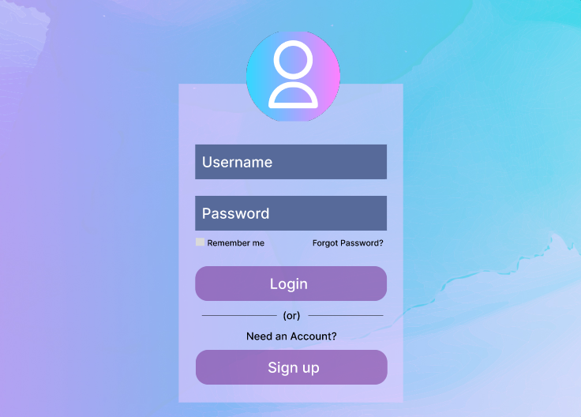
Login page with Username and Password

Slide 3
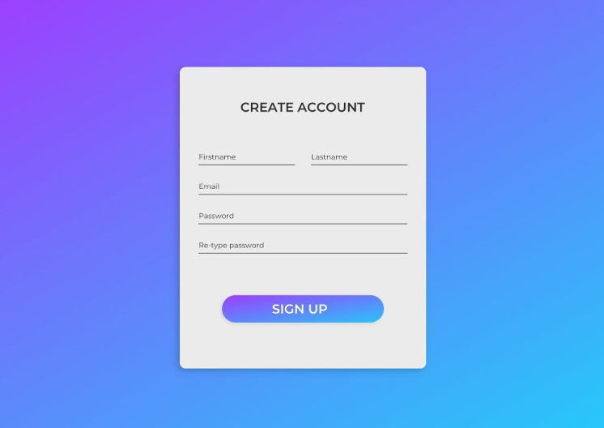
Sign up Page

Slide 4
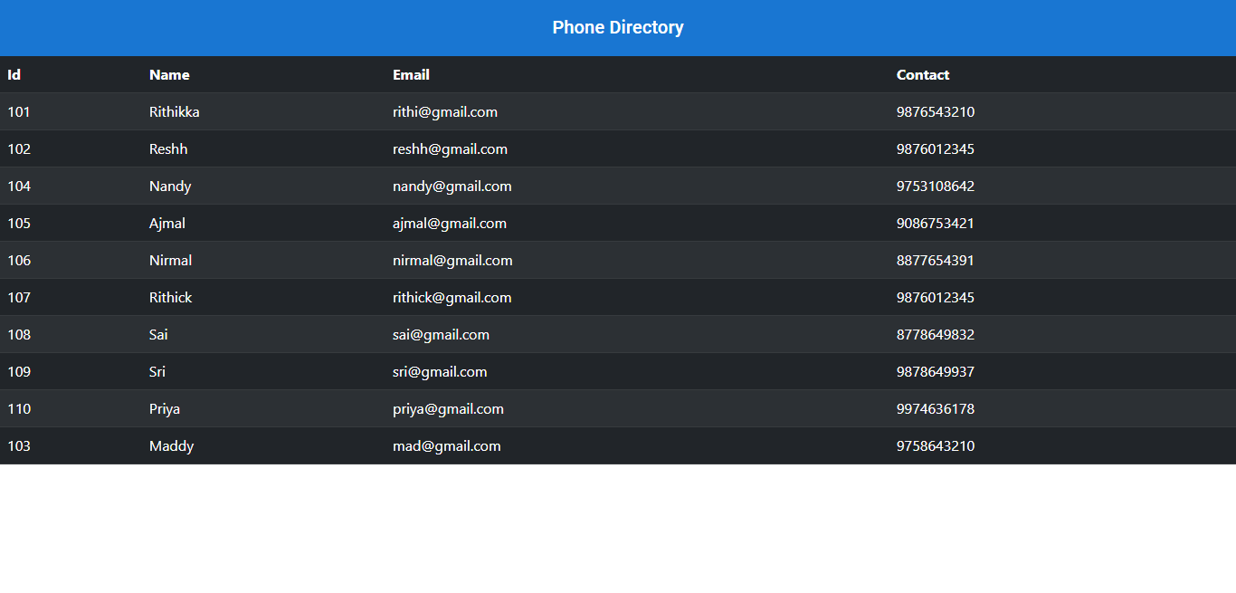

Slide 5
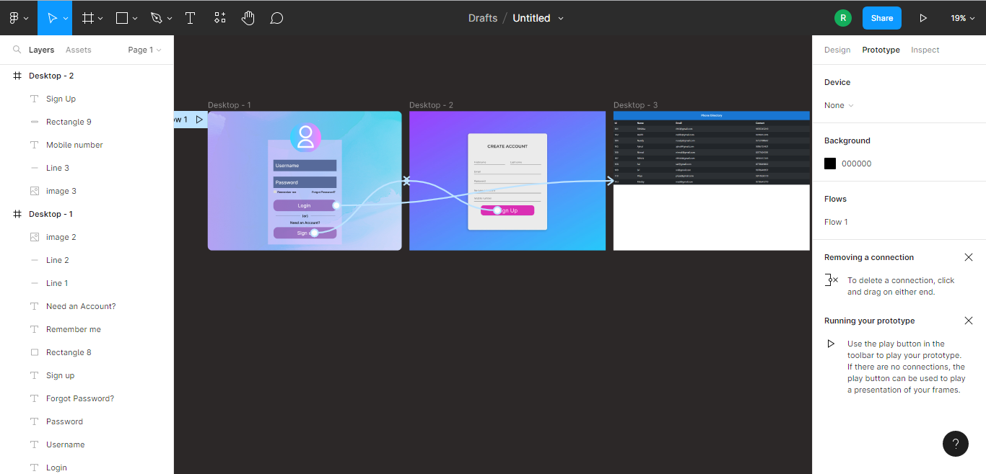
Prototype

Slide 6
Project URL :
https://www.figma.com/proto/XzEpYRQAqT9OQ2C85WocNi/Untitled?node-id=1%3A2&scaling=scale-down&page-id=0%3A1&starting-point-node-id=1%3A2

Slide 7


